Slide 1
“Time taken to test an Idea must be Zero”
NIRAJ DESAI

Slide 2
AGENDA
About me
Achievements and Milestones
Career Goal
Time Series Modelling – RNN and LSTMs
New Technologies
Projects – Research, Corporate and Exploring

Slide 3
About me
A Short Summary.

Slide 4

About me
A self motivated and an optimized professional with a Masters of Business Administration specialized in Artificial Intelligence and Data Science, who believes KDD (Knowledge Discovery in Data) is the new normal of 21st Century. Generic rather than a specialist and I wish to align my mathematical, statistical and computing knowledge with correct business acumen on the right data to generate value and optimized solutions which can help society as a whole move forward.

Slide 5
About me
Career Objective : As a professional I would like to be an optimized professional and a generalist and would harvest data and derive insights out of it in various domains leading to value by aligning various know-hows and business/domain acumen with statistical and computing knowledge.
Skills : Artificial Intelligence, Web Development, Design Thinking, Research oriented practices, Management and Administration, Business Intelligence and Analytics, Mathematical and Statistical inclined mindset, Container Technology
Hobbies : Football, Badminton, Singing, Video games, Hiking and Biking

Slide 6
Achievements and Milestones
Accomplishments over the years.

Slide 7
Achievements and Milestones
University Ranker for Final Year Software Project Development (Under Grad)
Made a 3 Tier Web Application for Bed and Breakfast reservations and booking
Technology Used : C#.NET Framework, HTML, CSS, Java Script, MySQL, Plugins and Google API merged with Google Analytics
University Ranker for Best Internship (Post Grad)
University Ranker for Best Dissertation (Post Grad)
Thesis : “A Temporal Study on Stock Market Index using Deep Learning and Semantic Analytics”
Business Ideathon
Took part in a hackathon workshop held company wide and won.
Design Thinking Workshop Framework across Company

Slide 8
Career Goal
Years down the line.

Slide 9
Career Goal
Short – Term Goals
Work on various types of Data sets and achieve expertise and in-depth knowledge
Explore various domains of data and business and creating possibilities of what could be achieved
Regular inputs and insights (Sharing voice, thoughts)
Financial Risk Management Charter OR Certificate in Quantitative Finance
Long – Term Goals
Going up in the hierarchy and lead business deriving value
Select an industry (Retail, Finance, Healthcare etc.) and align AI to that field (Converging to become a specialist)

Slide 10

Time Series Modelling – RNN and LSTMs
Thanos’ Snap.

Slide 11
Introduction
A Time Series (TS) is a series of data points indexed or listed in time order. Most commonly, a time series is a sequence taken at successive equally spaced points in time. Thus it is a sequence of discrete-time data. Examples of time series are heights of ocean tides, counts of sunspots, and the daily closing value of the Dow Jones Industrial Average.
There are different kinds of time series which can be classified:
Seasonal
Cyclic
Trend/Pattern
Random

Slide 12
Traditional approach to time series
Time series forecasting is always an hot topic in field of statistics, research and KDD. Earlier the statisticians used to perform Time series modeling by various tests and predict the future growth of company. Now, many rely on ARIMA models.
ARIMA stands for Auto Regressive Integrated Moving Averages which is a very feasible way to predict/ forecast future of structured data.
Why they failed?
Time Series Data is a subset of Sequential Data. It is a sequence basically. With rise of Social Media and especially twitter and blogging sites, business wants to know more about customer sentiments rather than just predicting using numbers.
If trained on one variable, it cannot be used on other variable, leading to misleading accuracies and error resulting into false judgements and decisions.
Hyper parameter Tuning is very much limited.

Slide 13
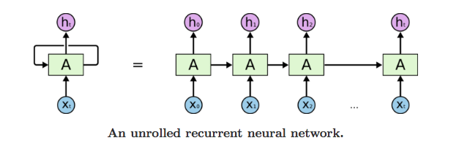
Enter Recurrent Neural networks
A simple example, consider that we want to predict the next number of the following sequence: 6 -> 7 -> 8 -> ?. We would like to have the next output to be 9 (x+1). However, if we provide this sequence: 2 -> 4 -> 8 -> ?, we would like to get 16 (2x). Although in both cases, the current last input was number 8, the prediction outcome should be different
The idea behind RNNs is to make use of sequential information. In a traditional neural network we assume that all inputs (and outputs) are independent of each other. But for many tasks that’s a very bad idea. If you want to predict the next word in a sentence you better know which words came before it. RNNs are called recurrent because they perform the same task for every element of a sequence, with the output being depended on the previous computations and you already know that they have a “memory” which captures information about what has been calculated so far.

Slide 14
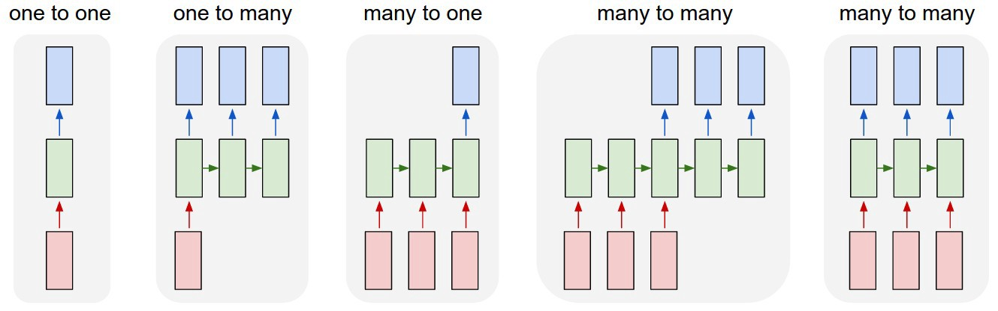
Enter Recurrent Neural networks
The core reason that recurrent nets are more exciting is that they allow us to operate over sequences of vectors: Sequences in the input, the output, or in the most general case both.

Slide 15
How they work
Let’s look at a cell of the RNN to see how you would calculate the hidden state. First, the input and previous hidden state are combined to form a vector. That vector now has information on the current input and previous inputs. The vector goes through the tanh activation, and the output is the new hidden state, or the memory of the network.
It has a very few operations internally but work well when time data consists of short sequences.

Slide 16
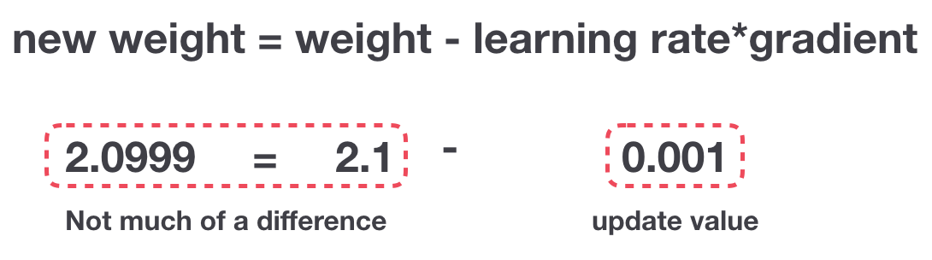
Vanishing Gradient Problem
Recurrent Neural Networks suffer from short-term memory. If a sequence is long enough, they’ll have a hard time carrying information from earlier time steps to later ones. So if you are trying to process a paragraph of text to do predictions, RNN’s may leave out important information from the beginning.
So because these layers don’t learn, RNN’s can forget what it seen in longer sequences, thus having a short-term memory.
So in recurrent neural networks, layers that get a small gradient update stops learning. Those are usually the earlier layers.

Slide 17
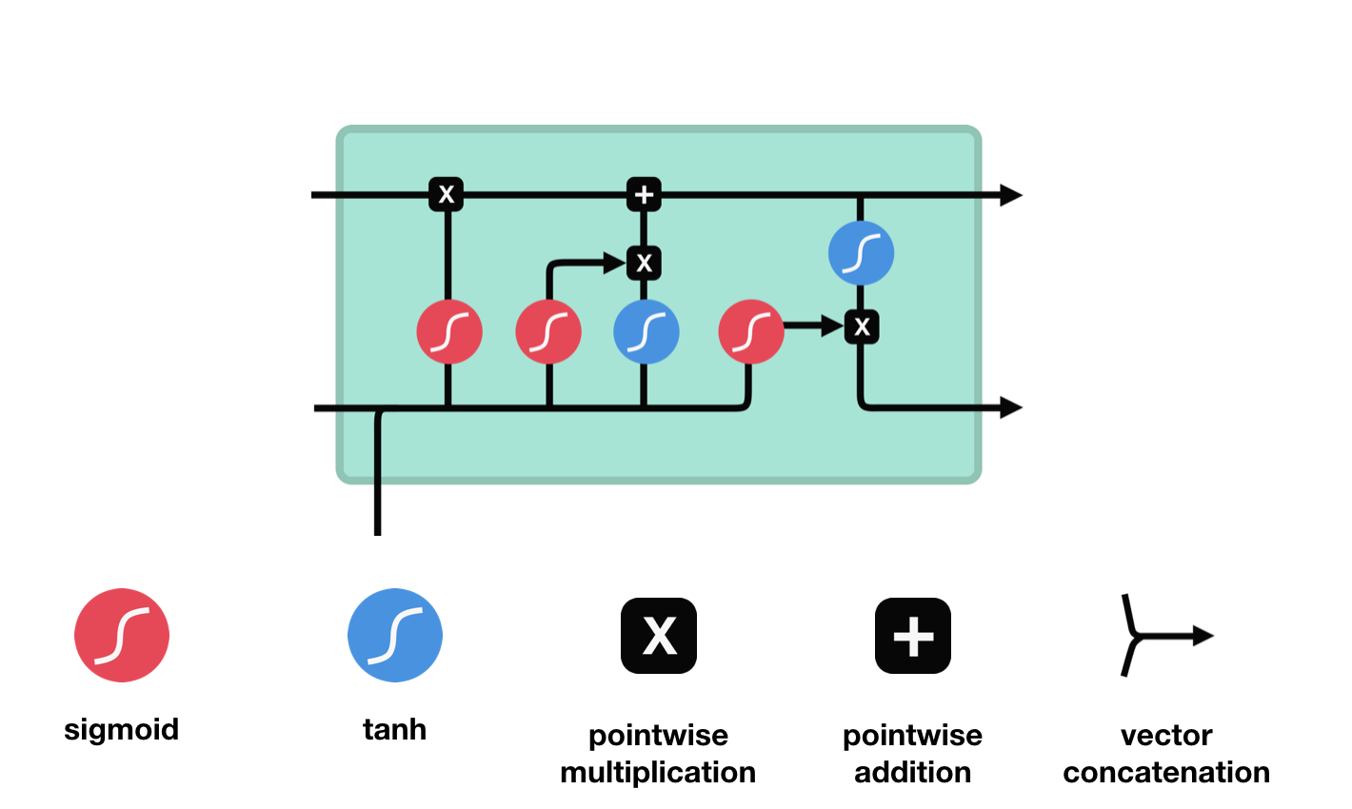
LSTM (Long short term memory)
LSTMs are a special kind of RNNs which are capable of learning long term dependencies. The core concept of LSTM’s are the cell state, and it’s various gates. The cell state act as a transport highway that transfers relative information all the way down the sequence chain. You can think of it as the “memory” of the network. The cell state, in theory, can carry relevant information throughout the processing of the sequence. So even information from the earlier time steps can make it’s way to later time steps, reducing the effects of short-term memory. As the cell state goes on its journey, information get’s added or removed to the cell state via gates.

Slide 18
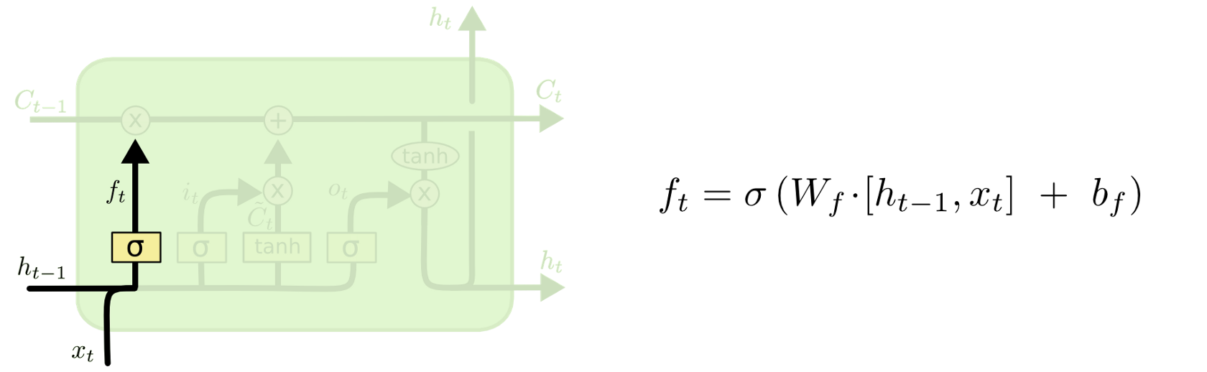
How they work
LSTMs have three gates : Forget Gate, Input Gate and Output Gate
Let’s Learn by an example how LSTMs works:
Forget Gate : Decides how much of the past you should remember.
lets say previous statement in sequence →Niraj and Chandler plays well in basket ball.
Current Input →Niraj is really good at web designing.
Forget gate realizes that there might be change in the context after encounter its first full stop .Compare with Current Input Current Input. Its important to know that next sentence, talks about Niraj, so information about Chandler is omitted.

Slide 19
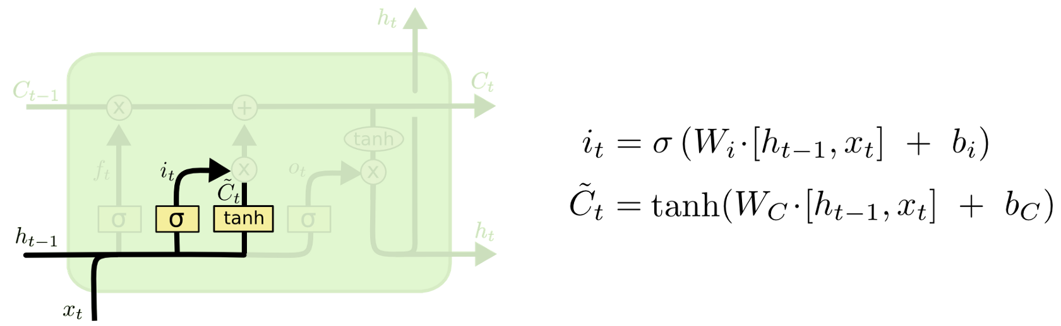
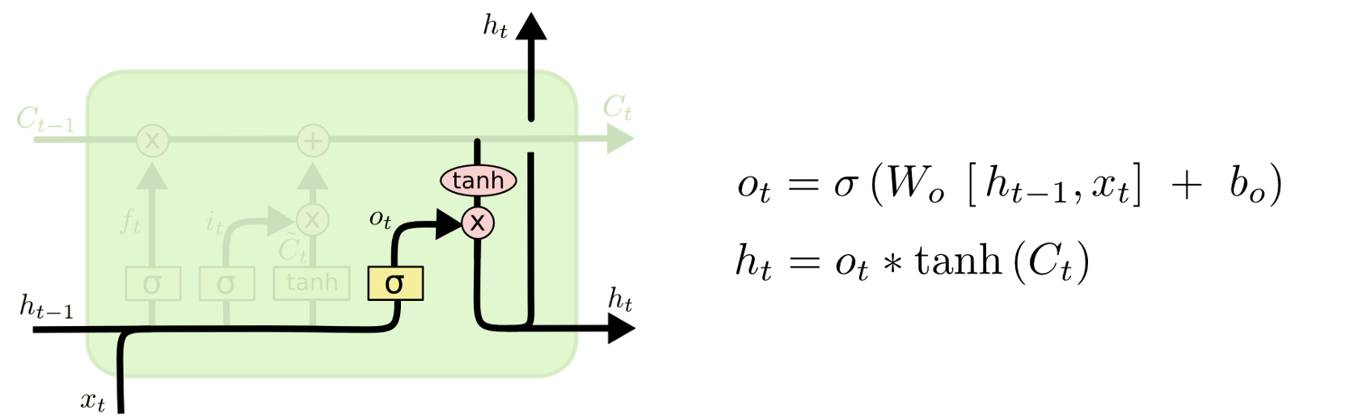
How they work
Input gate: Decides how much of this unit is added to the current state.
EX: Niraj good webdesigining, yesterday he told me that he is a university topper.
input gate analysis the important information.
Niraj good webdesigining, he is university topper is important.
yesterday he told me that is not important, hence forgotten.
Output Gate: Decides which part of the current cell makes it to the output.
EX: Niraj good webdesigining, he is university topper, he plays basketball so the Merit student _______________ was awarded University Gold medalist.
Output gates automatically learns to keep relevant information and there could be lot of choices for the empty dash. this final gate replaces it with Niraj.

Slide 20
Voila !
Basically, an LSTM will link long term attributes of an entity and keep in memory the most relevant information from the whole sequence.

Slide 21
New Technologies
The new trends in AI

Slide 22
New Technologies
XAI (eXplainable Artificial Intelligence):
Most of the AI projects fail or stop at POC, the reason being they are black boxes, when real money is involved customers, users don’t want to invest into something that cannot be explained leading to trust issues. There is no accountability with AI. XAI is a framework which can turn these black boxes to white boxes. They can answer why AI made this decision, When will AI take right decision, When it will fail.
Reinforcement Learning/ Q-Learning:
Reinforcement Learning is the new frontier in Artificial Intelligence. With RPA just around the corner, Reinforcement Learning leads to AGI from where an AI can achieve human like intelligence like playing chess or other games, learn to walk and driving self driving cars.

Slide 23
Projects – Research, Corporate and Exploring
Exciting Work.

Slide 24
Projects – Research, Corporate and Exploring
Sustainable Intelligence AI Engine
ESG Evaluations x CSR Activities
Prescriptive Analytics
XAI
Gene Data Analysis
Pharma covigilance and Post marketing AI
How effectively a medicine treats cancer using Gene Sequence data.
Outcome : Is there a possible chance of reoccurrence or not
Sketch 2 Code:
Turning Design Wireframes into HTML Front end codes using AI

Slide 25
Thank you.

